Slide 1
Welcome to CS1950u!
Introduction
Notes:
Welcome to Topics in 3D Game engine development (cs195u)!

Slide 2
Staff
Introduction

Slide 3

A word from our sponsor

Slide 4
Goals
Introduction

Slide 5
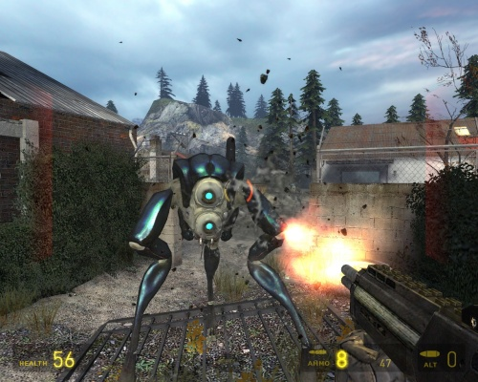
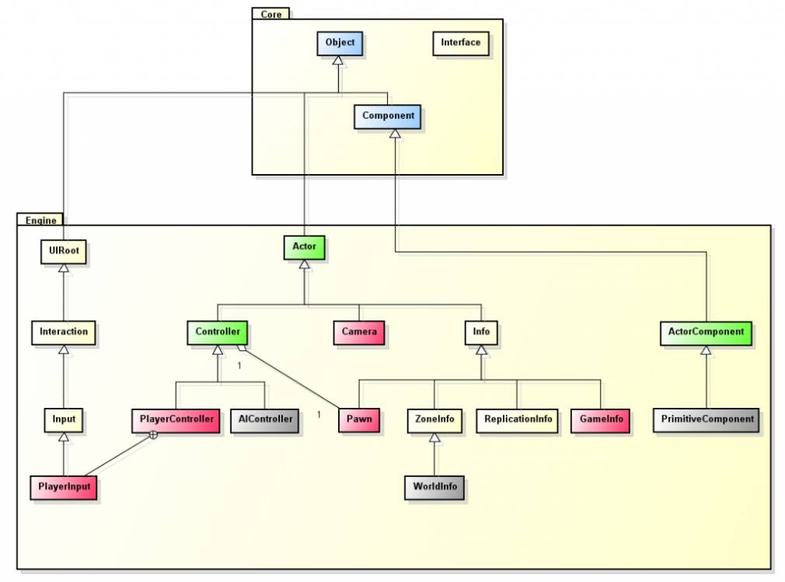

Class Goals
Build your own 3D game engine, from scratch!
Build games on top of your game engine!
Improve your software engineering and design skills!

Slide 6


Useful Skills
C++
Graphics/OpenGL
Basic vector math

Slide 7
Assignments
Introduction

Slide 8

Projects
Two projects split up into checkpoints
Some weeks give you choices!
One open-ended final project (individual or in groups)

Slide 9
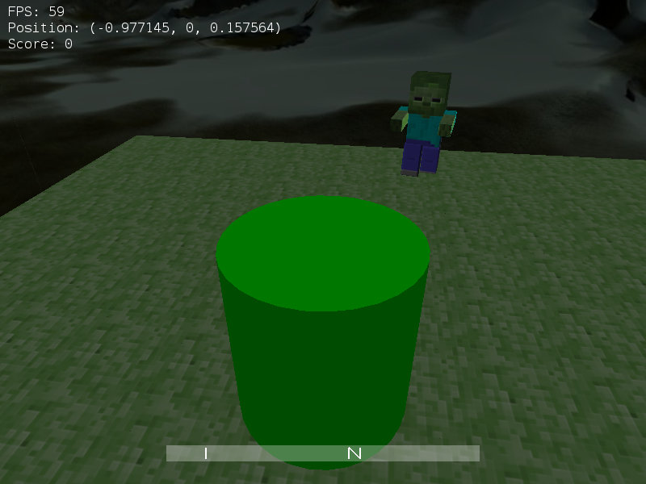
Warmup
Startup assignment to get familiar with working in 3D space
2 week project (2 checkpoints)
Basic engine architecture, graphics, controls

Slide 10
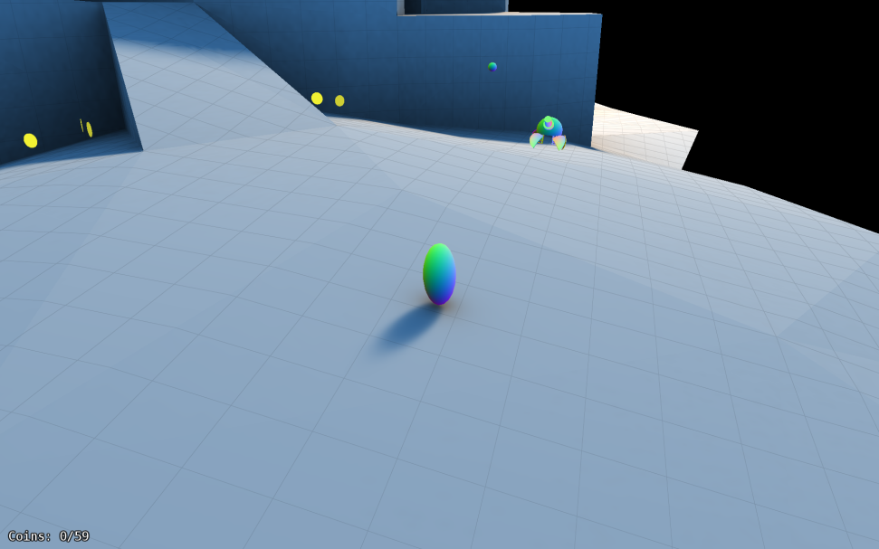
Platformer
4 checkpoints over 6 weeks
Topics:
collisions, rigid body physics
spatial acceleration
pathfinding, AI
UI/HUD
animation

Slide 11
Final
4 week project
Your choice of engine features
Your choice of game features
Groups encouraged, but not required
More details later
???

Slide 12
Class Roadmap
Week 1 (Basic Engine Architecture)
Week 2 (Gameworld, ECS, Systems)
Week 3-4 (Ellipsoid/Triangle, Sphere/Cylinder/AAB Collisions)
Week 3-4 (GJK, EPA Collisions)
+ Rigid Body Physics (if you want)

Slide 13
Class Roadmap
Week 5 (Engine Optimizations – spatial subdivision, frustum culling, chunk streaming, texture atlases)
Week 6 (Pathfinding, AI)
Week 7-8 (UI)
Week 7-8 (Skeletal Animation)
Week 9-12 (Final Project)

Slide 14
Grading
Introduction

Slide 15
Grading
Only projects
Grades and feedback will be given on Canvas
Handins due on Monday at 11:59 PM, except for final, which is due on Sunday 4/18 at 11:59 PM
Checkpoints are worth 3 points (except for collisions checkpoint which is worth 6 points), final is worth 9 points

Slide 16
Grading
For each checkpoint, you have…
Engine requirements
Game Requirements
You can get extra credit by implementing extra features

Slide 17
Final Grades
No curve!
Do the work, get an A
30 points possible across all projects, not counting extra credit
Need to complete all primary engine requirements and a final project

Slide 18
Grading
Points | Missing | Grade
27+ | 0-3 | A
24-26 | 4-6 | B
23- | 7+ | C

Slide 19
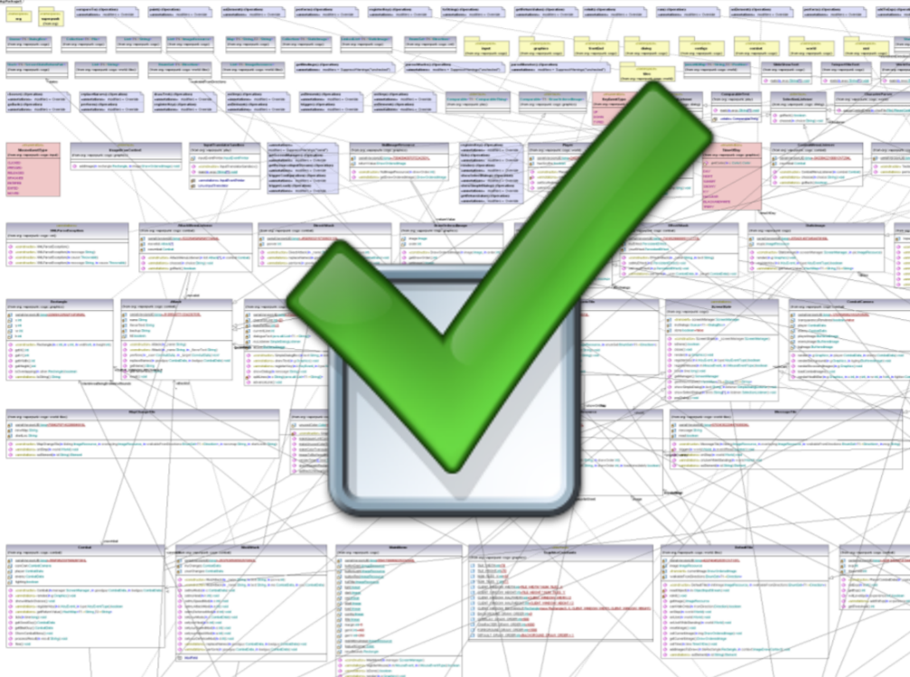
Design Checks
High-level conceptual questions
Gives one standard retry, which bring us to …

Slide 20
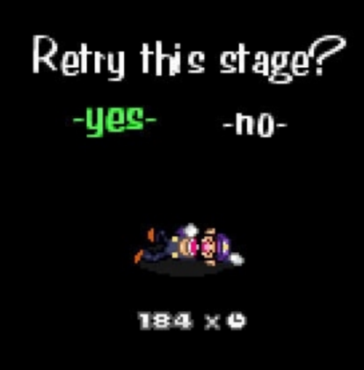
Incomplete Handins
Standard Retry
As long as you complete a design check, you are allowed to re-hand in a checkpoint
Extra retries
You have two for the whole class
Can use to retry a checkpoint that you already retried
You have a week to use each retry (from when you get your grade back)

Slide 21
Incomplete Handins
Minimum requirements cannot be retried
Extra credit can be retried
No extra credit until all requirements are met
Only your best handin will count (retries never hurt your grade)

Slide 22
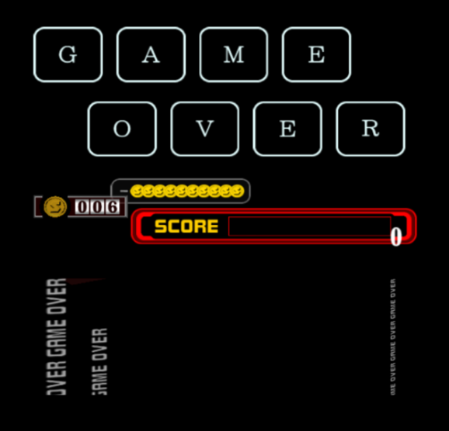
Out of Retries
Used the standard retry, out of extra retries, now what?
You can still do well in the class
Don’t have to get credit for all requirements
You can still pass the class
Hand in working version of all engine requirements by the end of the semester

Slide 23
Please hand in on time!
It can be hard to catch up in this class if you fall behind
If your handin is playable, hand it in even if you’re missing some reqs so you can be playtested
If it isn’t, you have another week to retry

Slide 24
Questions?
Introduction

Slide 25
Class Times
Introduction

Slide 26
Class Times
Class: Tuesday 9am-10:20pm (Zoom)
Design Checks and Hours: Thursday 9am – 10:20pm (Zoom)
Optional
Signmeup for design checks and hours
more hours TBA
Website: http://cs.brown.edu/courses/cs195u/

Slide 27
Expected hours

Slide 28
Other course policies
Introduction

Slide 29
Collaboration Policy
Full version is on our website
Short version:
Can discuss lectures and assignments
Can play each other’s games
Cannot look at or give any code
Can cooperate with other students during TA hours (at TA discretion)

Slide 30
CS1950U as a Capstone
Requirements
More final project engine features
Students taking the capstone should get their project proposals approved before March 22 so that they can start early
See the final project handout for details
Capstone form filled out, signed by Daniel Ritchie
That’s it!

Slide 31
Slack
We are using Slack instead of Piazza this semester
Email course staff if you have not been invited to the Slack workspace
There is a public “help” channel
You can DM me for private questions
I’ll paste questions and answers into the help channel if I think they would be helpful to others (question asker will remain anonymous)

Slide 32
Style Guide
We expect you to have a reasonable style, but don’t require any specific style guide
If you’re unsure of what counts as reasonable style, pick your favorite style guide from a course you’ve taken and follow it

Slide 33
Test Your Code
Your code needs to compile and run on department machines
Let me know if there is a problem with FastX
We can’t grade it if we can’t run it
Should run at 20+ FPS

Slide 34
About Registration
Introduction

Slide 35
Registering for CS1950U
If you can’t register for CS1950U because you don’t meet the prerequisites
Don’t panic
Request an override in Courses@Brown

Slide 36
Registering for CS1950U
If you can’t register for CS1950U because you’re a RISD student
Don’t panic
Email our professor (Daniel Ritchie)

Slide 37
Questions?
Introduction

Slide 38
Introductions!
Please share
Your name
Your pronouns
A video game you enjoy!

Slide 39
What is a game engine?
Basic Engine Architecture

Slide 40

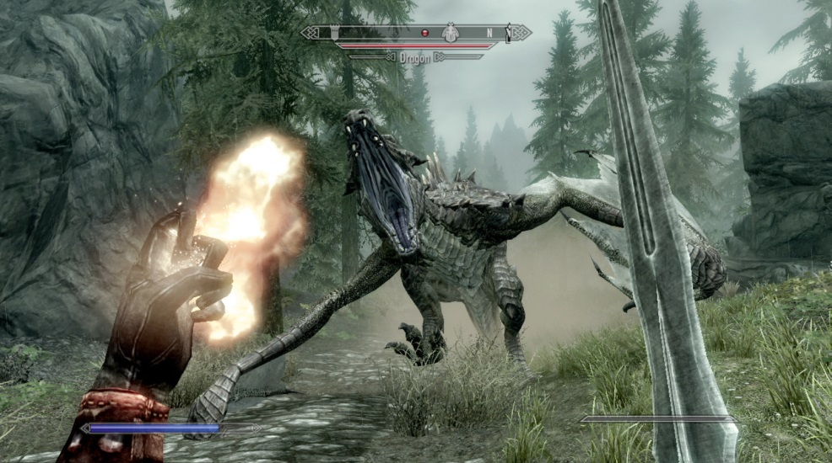
What is a game engine?
The things that games are built on
Games tend to have a ton of functionality in common
Create engines that abstract out common functionality

Slide 41
What is a game engine?
Usable by many games
It should be able to easily create a game without modifying engine code
Should be general
No game-specific logic!
Dungeon
Crawler
Warmup
Platformer
Engine

Slide 42
What does this look like?
Sample hierarchy
src/
engine/
Screen.cpp
Screen.h
warmup/
WarmupScreen.cpp
WarmupScreen.h

Slide 43
What does this look like?
Engine code should never #include game files

Slide 44
AN ESSENTIAL interface
Basic Engine Architecture

Slide 45


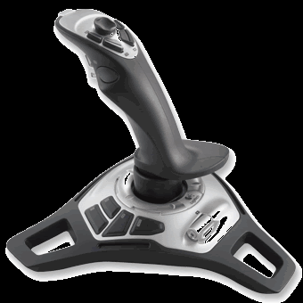
A game generally needs…
Timed updates (ticks)
To render to the screen (draws)
Input events
Resize events

Slide 46
Ticks
General contract:
void tick(float seconds)
Tells the game that a given amount of time has elapsed since the previous tick
Nearly all logic takes place during ticks
No drawing should take place during ticks

Slide 47
Draws
General contract:
void draw(Graphics *g);
void draw();
Tells the game to draw itself
Convert game state into viewable form
No side effects from draw calls
More information coming up in Graphics section

Slide 48
Input Events
Most APIs provide input events rather than making you manually poll mouse and keyboard
Exact contract differs depending on type, but usually of the form:
void onDDDEEE(QDDDEvent *event);
DDD = device type (e.g. mouse, key)
EEE = event type (e.g. moved, pressed)
Tells the game that an event has occurred
Event object contains information about the event
e.g. how far the mouse moved; what key was pressed...

Slide 49
Putting it Together
The Application class
class Application {
public:
void tick(float seconds);
void draw(Graphics *g);
void onKeyPressed(QKeyEvent *event);
// more device and event types here...
void onMouseDragged(QKeyEvent *event);
}

Slide 50
Putting it Together
Application represents an instance of a game
You will implement an Application class in Warmup1

Slide 51
Questions?
The Most Basic Interface

Slide 52
SCREEN Management
Basic Engine Architecture

Slide 53
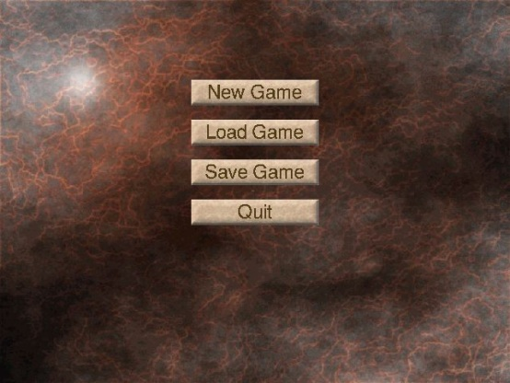
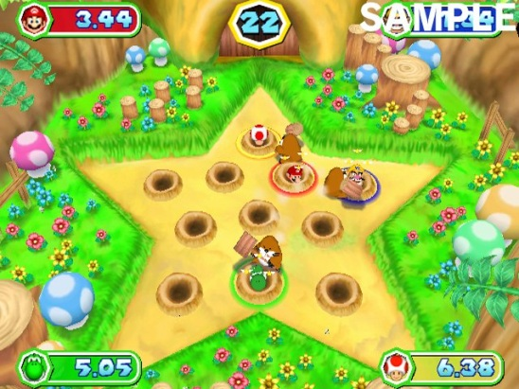
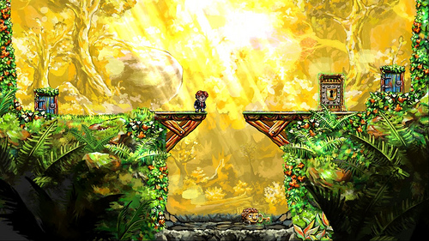
We have an Application
But how do we build a game around that?
Drawing/ticking/event handling is very different depending on what’s going on!
Menu system
The actual game
Minigames within game

Slide 54
Screens within Application
Rather than keeping track of “modes”, separate each “mode” into a dedicated Screen subclass
MenuScreen, GameScreen, etc.
A Screen has similar methods to the Application
tick
draw
input event methods

Slide 55
Keeping track of Screens
Events
Simplest way:
Single Screen in Application at a time
Application forwards all events to this screen
Alternatively:
Map of Screens maintained by the Application
Screens can consume events or pass them to a different screen
Application
Game screen
Screen map
Notes:
Can give example of setting screen during class if people are puzzled
Use case of screen list: multiple screens need information simultaneously, multiple screens drawn (ex. Menu open with game in background, etc.)

Slide 56

What are Screens good for?
For Warmup1, Screens may
Draw the entire game
Handle all of the game logic
In general, Screens shouldn’t do this
Results in serious spaghetti code
Solution: GameWorld
Covered next week…

Slide 57
Questions?
Application Management

Slide 58
Camera
Camera and Graphics
Notes:
Talk about the idea of using a virtual “camera” for rendering our 3D game world, and how we’ll achieve first person view of our world using this idea

Slide 59
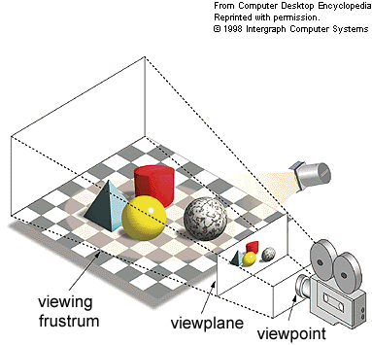
Cameras
Physical camera will render a “film” – a 2D representation of the 3D space
For virtual cameras, goal is similar
Render by squashing view volume (or frustum) onto 2D plane
Notes:
Virtual camera, goal is similar, but what does it mean?
Squash 3D scene onto cross section of frustum
That’s what rendering means for our virtual camera

Slide 60

Cameras in 3D Space
Camera is not very useful unless we know
Where it is (position)
What its orientation is (pitch, roll, yaw)
Notes:
If you tell me there’s a camera somewhere in the world, that’s not very useful

Slide 61
Camera Orientation
Yaw
Stick a pin in the top of the camera and rotate it around it by this angle
Pitch
The camera looking up and looking down by this angle
Roll
Only really used in flight simulators
Notes:
If you tell me there’s a camera somewhere in the world, that’s not very useful

Slide 62
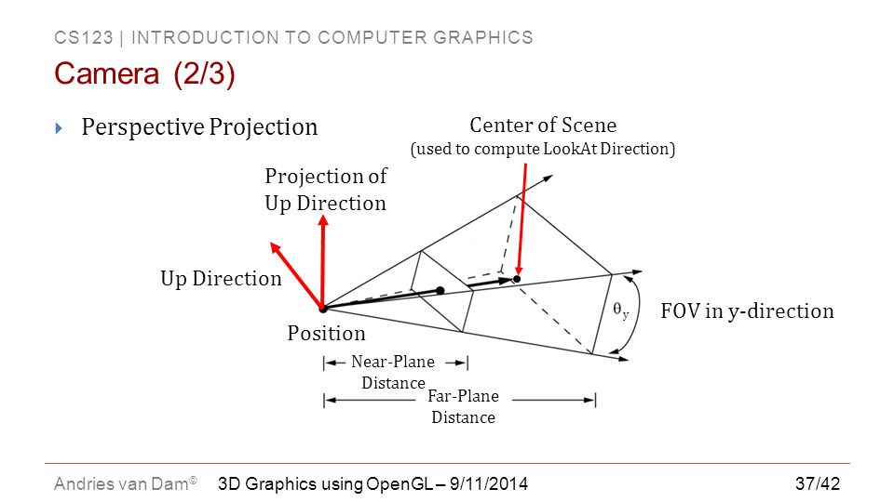
Camera Orientation
Alternatively…
Specify direction the camera is facing as a vector
Called the “look vector”
Notes:
If you tell me there’s a camera somewhere in the world, that’s not very useful

Slide 63
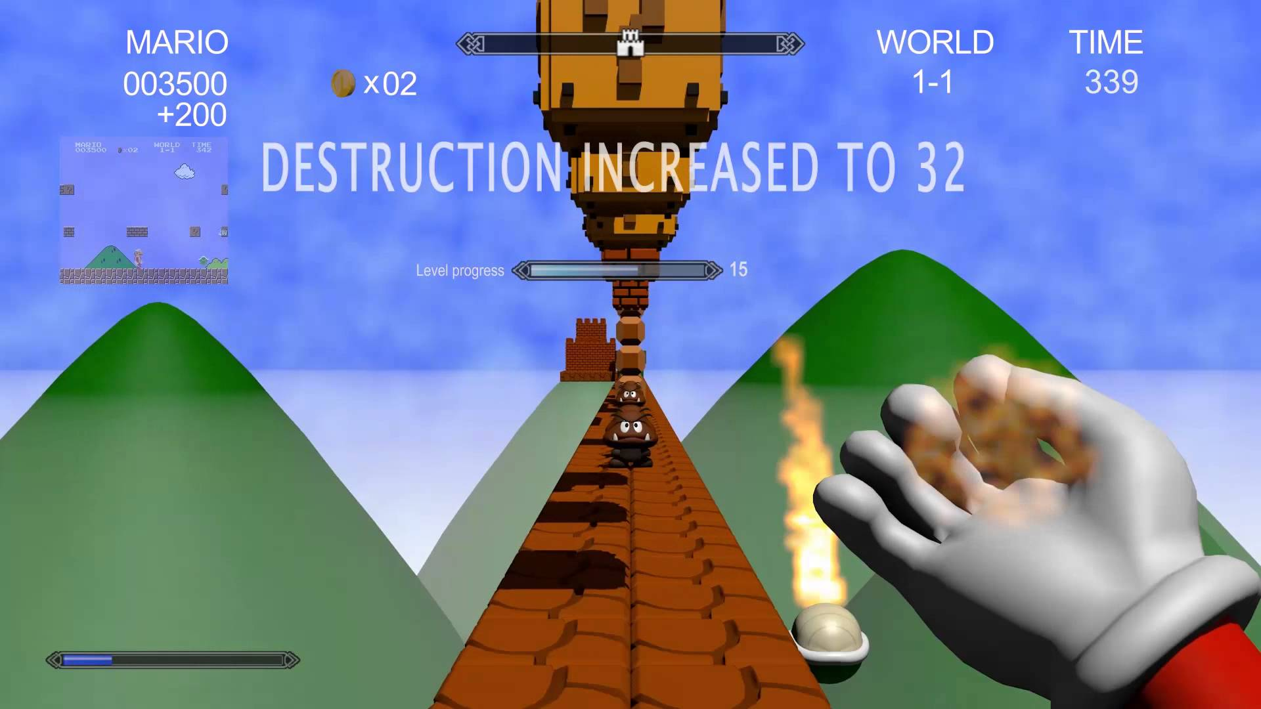
Camera position
Position of camera in the world
For Warmup 1, in order to achieve first person…
Make camera position same as player position
Update camera position to make the same as player position
Notes:
Talk about parameters of virtual camera, leveraging camera to get first person view, movement
These describe orientation

Slide 64
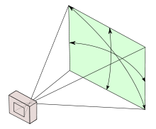
Other Camera Parameters
Field of view angle
How wide is the view volume?
Aspect ratio
Ratio of the width of screen to the height of the screen
Notes:
Talk about parameters of virtual camera, leveraging camera to get first person view, movement
These describe orientation

Slide 65
Our Camera Class
Default Camera class provided
src/engine/graphics/Camera.h(cpp)
Allows you to specify all of the above attributes
Most likely will only modify position, pitch, yaw

Slide 66
Questions?
First Person Camera

Slide 67
Basic Graphics
Camera and Graphics

Slide 68
Motivation
Certain graphics calls are common to many games
Setting up a camera
Drawing shapes
Setting material properties for shapes
Drawing text
We can store all of our shapes, materials, fonts, etc. in one centralized object
Helps us not load them into memory more than once
Helps us keep track of them and delete them
Encapsulated in a “Graphics” object

Slide 69
Graphics Object
Default Graphics object provided
src/engine/graphics/Graphics.h(cpp)
Methods for …
Setting the active camera
This camera will be used for rendering
Drawing shapes
Rectangles (quads), cylinders, and spheres for now
Setting materials
Change color, texture, lighting of shapes
More!
Notes:
* Best thing to mitigate

Slide 70
Other Classes
src/graphics/Shape.h(cpp)
Describes the geometry of a shape
src/graphics/Material.h(cpp)
Describes material properties of a shape
More!
Notes:
* Best thing to mitigate

Slide 71
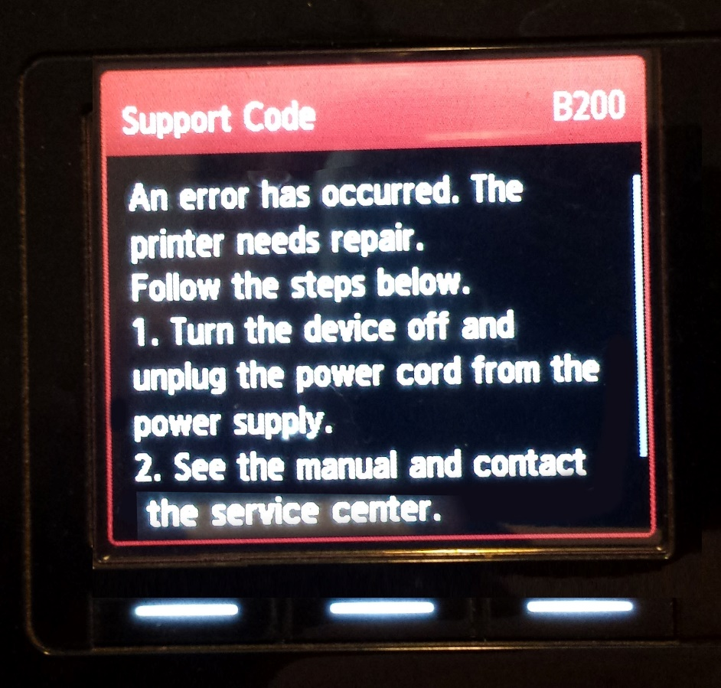
Doing it Yourself
Feel free to modify graphics support code!
Feel free to write your own graphics code!

Slide 72
Questions?
Basic Graphics

Slide 73
Player Movement
Controls

Slide 74
Coordinate systems
Different game engines define 3D coordinate systems differently
Most commonly:
“Horizontal plane”
Plane parallel to the ground (the xz-plane)
“Up-axis”
Axis perpendicular to horizontal plane (the y-axis)
y
x
z
Notes:
* Brief motivation of camera for 3D rendering
* Give example of coordinate system

Slide 75
Horizontal Movement
Keep track of your player position
Forward movement:
Use the horizontal component of the look vector
forward_speed = some positive constant
dir = normalize(look.x, 0, look.y)
pos = pos + forward_speed * dir
Strafing
Use the perpendicular of the horizontal direction
sideways_speed = some positive constant
perp = normalize(dir.z, 0, -dir.x)
pos = pos + sideways_speed * perp

Slide 76
Vertical Movement
Keep track of the player’s vertical position and velocity
Jump
Assign some positive velocity when the player jumps
Make sure the player is on the ground (pos.y == 0) before jumping
Apply gravitational acceleration each tick
dt = time since last tick
g = some negative constant
velocity = velocity + g * dt
pos.y = pos.y + velocity
Collision with ground
After moving the player, set pos.y = max(pos.y, 0)

Slide 77
Cs195u Support Code

Slide 78
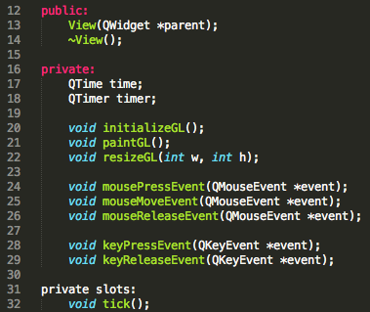
Support Code Overview
Qt Framework
main.cpp – starts up program, toggles fullscreen
mainwindow.h/.ui/.cpp – sets up window
view.h/.cpp – basic even framework, where your Application class should reside
Vector math – glm (important!)
2,3,4 dimensional vectors and matrices
Tons of math – see online documentation
QRC files
Allows for easy access of external resources
Can use to load your own resources
Notes:
Qt – windows and useful library of data structures (better api than stdlib)
Main & Mainwindow are Qt stuff you can ignore, although Main sets fullscreen
View is your entry point, handles updating, drawing, and events
Vector is like CS123Algebra, Vector2-4

Slide 79
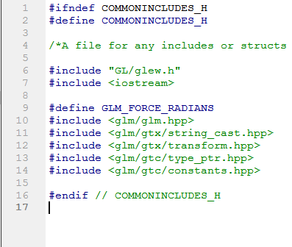
Support Code Overview
Utility
src/engine/util/CommonIncludes.h
Includes glm, iostream
Include this anywhere you need glm
Graphics
src/engine/graphics/*
Described in previous section
Notes:
Qt – windows and useful library of data structures (better api than stdlib)
Main & Mainwindow are Qt stuff you can ignore, although Main sets fullscreen
View is your entry point, handles updating, drawing, and events
Vector is like CS123Algebra, Vector2-4

Slide 80
Support Code Overview
Methods in view.h/.cpp
DDDEEEEvent(QEEEvent *event) – call app.DDDEEE(event)
tick(float seconds) – call app.tick(seconds)
paintGL() – call app.draw(graphics) or app.draw()
resizeGL(int x, int y) – call app.resize(dimensions)
Make Application a separate class from View!
Put instance of Application class in View, so that you can pass events on to Application
Notes:
Qt – windows and useful library of data structures (better api than stdlib)
Main & Mainwindow are Qt stuff you can ignore, although Main sets fullscreen
View is your entry point, handles updating, drawing, and events
Vector is like CS123Algebra, Vector2-4

Slide 81
Setup Guide
If you have time, go through the CS1950U setup guide! (highly recommended)
On the Docs page of the website
It covers …
How to set up a camera
How to draw something using the graphics object
How to add basic player controls

Slide 82
On Your Own
Play around with graphics object calls
Specifically try to move, resize and rotate shapes
3D graphics can be tricky, especially if you haven’t done it before
Feel free to email us or come to hours if there’s something you don’t understand

Slide 83

Qt vs. STDLib
QString – substrings, splitting, hashcodes
QList – type-generic dynamic array
QHash – type-generic hashtable
QSet – type-generic set
QTimer – sets up the game loop
QThread – easy-to-use threading API
QPair – great for vector hashcodes
http://qt-project.org/doc/qt-4.8/qtcore.html
Notes:
Much easier to use than c++ stdlib structures, no iterators necessary

Slide 84
Qt vs. C++ STDLib
QString – std::string
QList – std::vector
QHash – std::unordered_map
QSet – std::unordered_set
QPair – std::pair
http://qt-project.org/doc/qt-4.8/qtcore.html
Notes:
Much easier to use than c++ stdlib structures, no iterators necessary

Slide 85
SMART POINTERS
C++ Tip of the Week

Slide 86
Raw pointers
Problems:
Declaration doesn’t indicate who owns the object (i.e. who destroys it)
Must destroy exactly once
Memory leaks

Slide 87
Smart Pointers
The solution to all of the problems (and more)
Most importantly, delete / free object they refer to automatically if pointer goes out of scope
3 types in modern C++
std::unique_ptr
std::shared_ptr
std::weak_ptr

Slide 88
Shared Pointers
In general the one to use
Same size as raw pointers and perform the exact same instructions
Notes:
Ownership kind of means that only one unique_ptr should point to resource owned by it at a time.
For shared_ptrs, multiple shared pointers can own resource

Slide 89
Creating a Shared Pointer
Use “std::make_shared<T>(args);”
More verbose than creating a normal pointer, but worth it
Notes:
Ownership kind of means that only one unique_ptr should point to resource owned by it at a time.
For shared_ptrs, multiple shared pointers can own resource

Slide 90
Creating a Shared Pointer
With shared pointers
Without shared pointers
#include <memory> // Include header file
…
…
std::shared_ptr<Camera> cam =
std::make_shared<Camera>();
…
…
…
…
…
Camera *cam = new Camera();
…
…
delete cam;
Notes:
Ownership kind of means that only one unique_ptr should point to resource owned by it at a time.
For shared_ptrs, multiple shared pointers can own resource

Slide 91
Copying a Shared Pointer
Can make as many copies of a shared pointer as you want
std::make_shared<T> s1 = …;
std::make_shared<T> s2 = s1;
std::make_shared<T> s3 = s2;
…
Each refer to the same object
Object managed by all shared pointers only deleted when all shared pointers go out of scope
Notes:
Ownership kind of means that only one unique_ptr should point to resource owned by it at a time.
For shared_ptrs, multiple shared pointers can own resource

Slide 92
Avoid Shared Pointer Cycles
A shared pointer counts how many other objects reference it (i.e. how many copies of the shared pointer exist)
When this counter reaches 0, the shared pointer’s destructor is called
Do not create “cycles” of shared pointers!
If a shared pointer s1 owns a shared pointer s2 and s2 also owns a shared pointer of s1, you will get a memory leak!
Notes:
Ownership kind of means that only one unique_ptr should point to resource owned by it at a time.
For shared_ptrs, multiple shared pointers can own resource

Slide 93
Avoid Shared Pointer Cycles
Consider an Application a that owns a std::shared_ptr<Screen> s. If s owns a std::shared_ptr<Application> to a, then a cannot be destroyed without manually destroying s
Why? Consider the diagram below. Application a is referenced twice (by the rest of the program and by s)
When we destroy the rest of the program, Application a is not destroyed because its reference counter decreases from 2 to 1 (so the counter does not reach 0)
Rest of program
Application a
Screen s
Notes:
Ownership kind of means that only one unique_ptr should point to resource owned by it at a time.
For shared_ptrs, multiple shared pointers can own resource

Slide 94
Avoid Shared Pointer Cycles
It is very common for a Screen to want to reference the Application that owns it
We can have this behavior and avoid memory leaks by having the screen own a raw pointer to the application
This is safe to do because the Application owns the Screen, but the Screen does not own the application (shared pointers shown ownership)
This pattern will be useful when we talk about about GameWorlds, GameObjects and Components as well!
Notes:
Ownership kind of means that only one unique_ptr should point to resource owned by it at a time.
For shared_ptrs, multiple shared pointers can own resource

Slide 95
In Summary…
Unique/shared pointers make memory management easier
Please don’t have memory leaks in your handin code

Slide 96
Warmup 1 is released! Good luck!

